Slide 1
WADMIN18-0005 (Nay Shop)
Washoe County Board of Adjustment
December 6, 2018

Slide 2
Request
This is a request for an administrative permit to allow for the construction of a 4,000 sq. ft. detached accessory structure with electrical connection but no plumbing that will be larger than the building footprint of the 1,725 sq. ft. main structure
WCC Code 110.306.10(h) requires an Administrative Permit when an accessory structure is large than the existing main structure

Slide 3
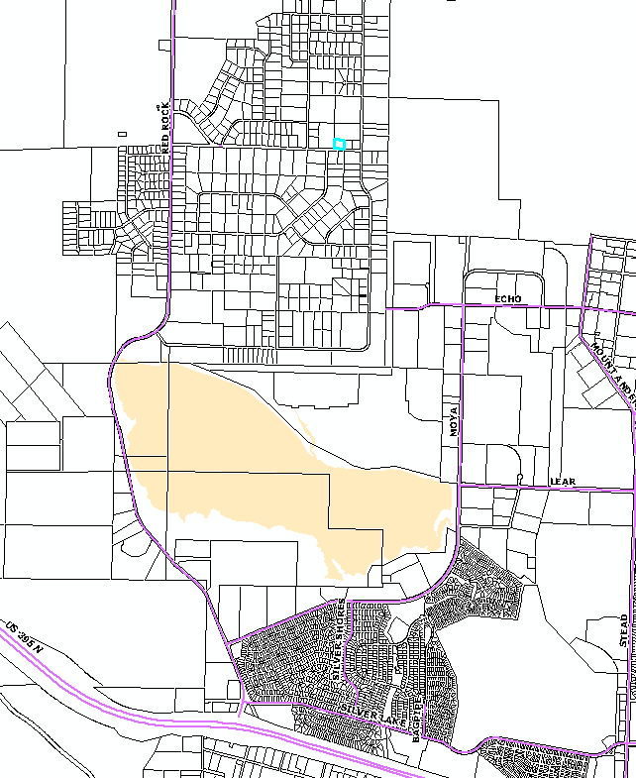
Location
Project Site Location
The 1.15 acre site is located at 10205 Silver Knolls Blvd.
The property is zoned Low Density Suburban (LDS)

Slide 4
Background
The proposed structure will be located on the west side of the property
It will be 32 feet from the rear property line and 12 from the side, which meets the setback requirements
The application was delayed to resolve a private roadway easement along the west side of the property, which has been vacated

Slide 6
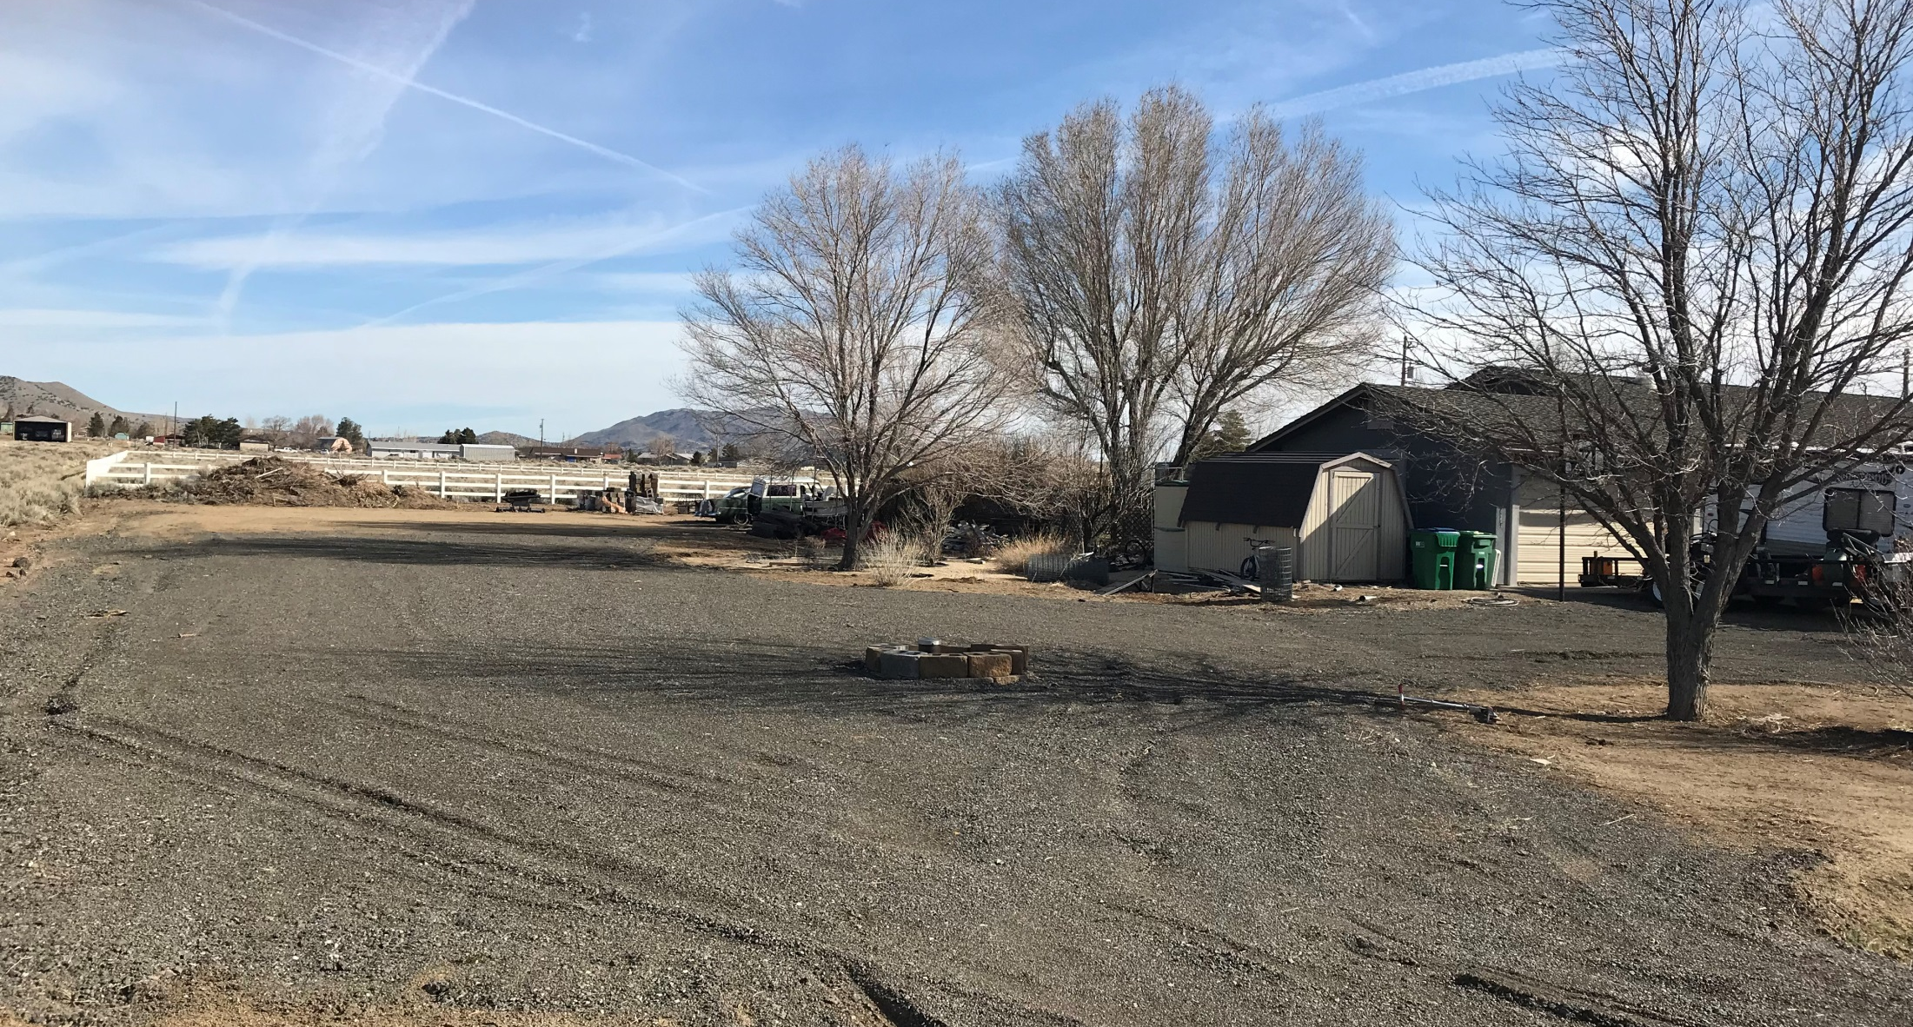
Looking North

Slide 7
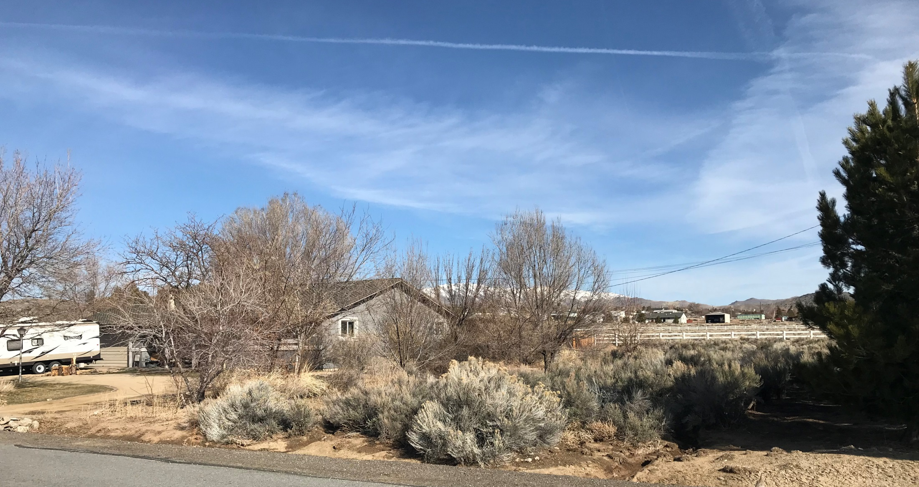
Looking Northwest

Slide 8
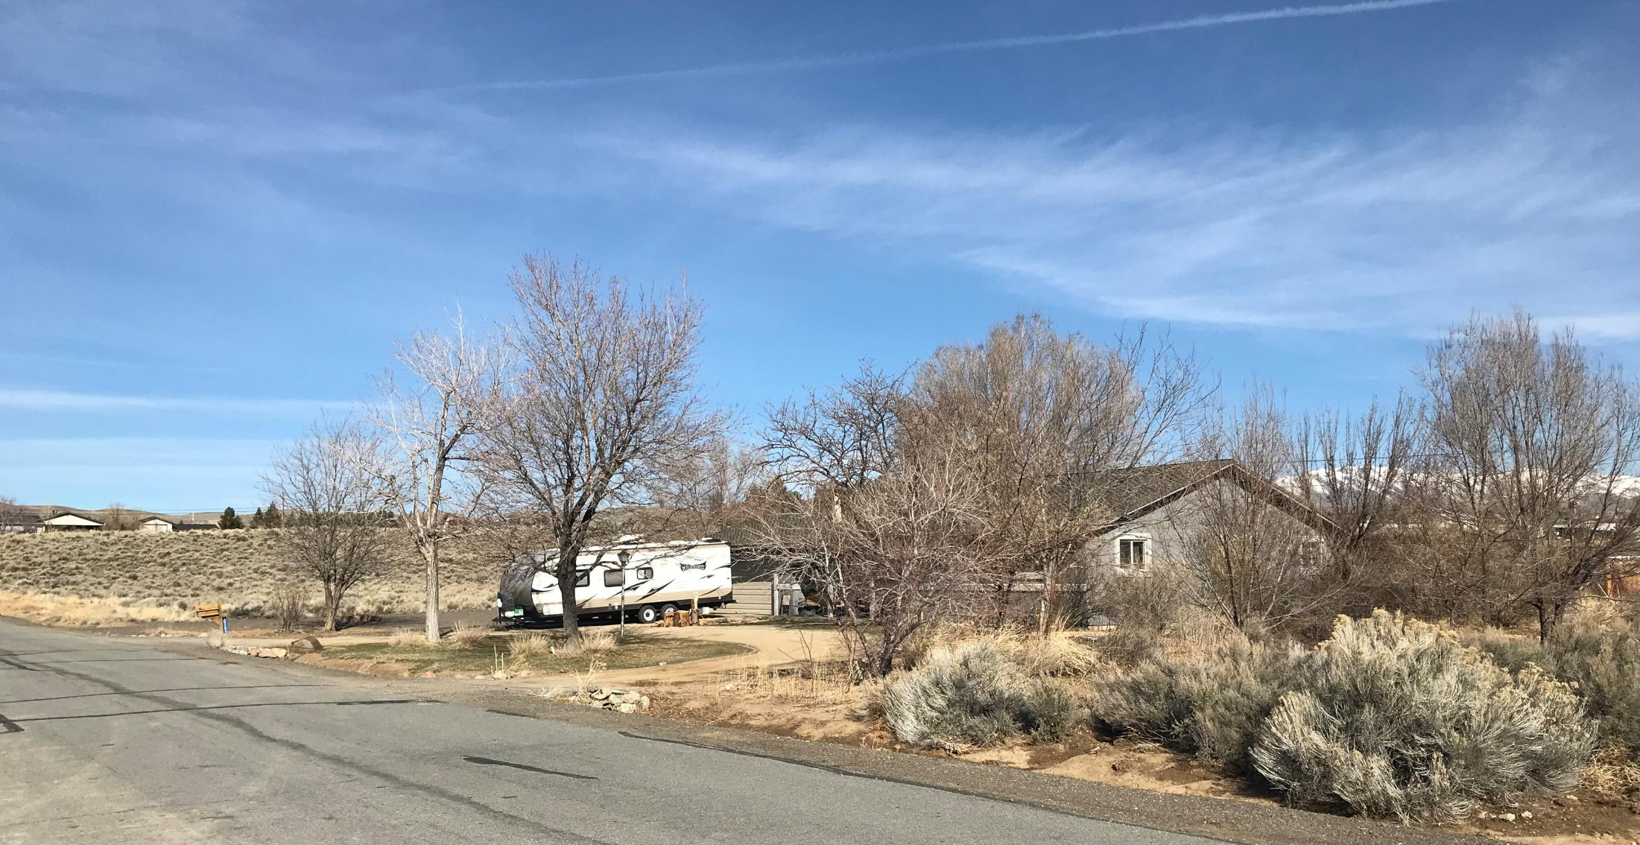
Looking West

Slide 9
Building Information
The applicant has indicated the structure will be used as a hobby shop and boat/RV storage
It will be metal building painted grey with a charcoal color roof
There are other accessory structures in the area

Slide 10
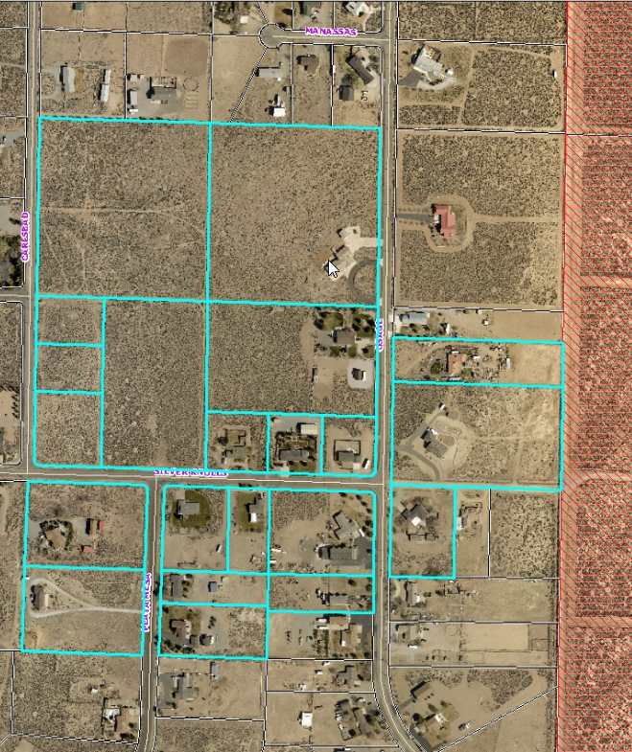
Noticing Map
21 parcels were noticed within 500 feet of the site

Slide 11
Reviewing Agencies
2 of the 6 reviewing agencies provided conditions, which are included in your staff report.

Slide 12
Administrative Permit Findings
Consistency;
Improvements;
Site Suitability;
Issuance Not Detrimental
Staff is able to make all 4 required findings, as shown in the staff report on page 9-10 and recommends approval

Slide 13
Possible Motion
I move that, after giving reasoned consideration to the information contained in the staff report and information received during the public hearing, the Board of Adjustment approve Administrative Permit Case Number WADMIN18-0005 for Charles and Nicole Nay, with the conditions of approval attached as Exhibit A to this matter, having made all four required findings in accordance with Washoe County Code Section 110.808.25

